Slide 1

Full and Para Virtualization
Dr. Sanjay P. Ahuja, Ph.D.
Fidelity National Financial Distinguished Professor of CIS
School of Computing, UNF

Slide 2
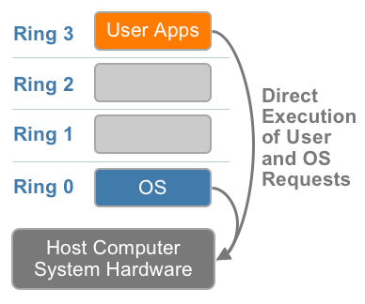
x86 Hardware Virtualization
The x86 architecture offers four levels of privilege known as Ring 0, 1, 2 and 3 to operating systems and applications to manage access to the computer hardware. While user level applications typically run in Ring 3, the operating system needs to have direct access to the memory and hardware and must execute its privileged instructions in Ring 0.
x86 privilege level architecture without virtualization
Notes:
Virtualizing the x86
architecture requires placing a virtualization layer under
the operating system (which expects to be in the
most privileged Ring 0) to create and manage the
virtual machines that deliver shared resources.
Further complicating the situation, some sensitive
instructions can’t effectively be virtualized as they have different semantics when they are not
executed in Ring 0. The difficulty in trapping and translating these sensitive and privileged
instruction requests at runtime was the challenge that originally made x86 architecture
virtualization look impossible.

Slide 3
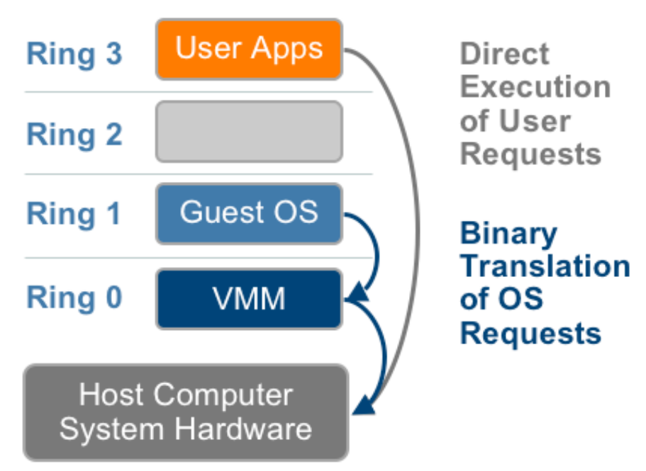
Technique 1: Full Virtualization using Binary Translation
This approach relies on binary translation to trap (into the VMM) and to virtualize certain sensitive and non-virtualizable instructions with new sequences of instructions that have the intended effect on the virtual hardware. Meanwhile, user level code is directly executed on the processor for high performance virtualization.
Binary translation approach to x86 virtualization
Notes:
Each virtual machine monitor provides each Virtual Machine with all the services of the physical system, including a virtual BIOS, virtual devices and virtualized memory management.
In the traditional x86 architecture, operating system kernels expect direct CPU access running in Ring 0, which is the most privileged level. With software virtualization, guest operating systems cannot run in Ring 0 because the VMM sits there. The guest operating systems must therefore run in Ring 1, but there's a catch: Some x86 instructions work only in Ring 0, so the operating systems must be recompiled to avoid them. This process is called paravirtualization, and it is impractical — especially if the source code for the OS is not available. To get around this, VMMs traps these instructions and emulates them, which unfortunately results in an enormous performance hit: Virtual machines can be significantly slower than real physical ones.

Slide 4
Full Virtualization using Binary Translation
This combination of binary translation and direct execution provides Full Virtualization as the guest OS is completely decoupled from the underlying hardware by the virtualization layer.
The guest OS is not aware it is being virtualized and requires no modification.
The hypervisor translates all operating system instructions at run-time on the fly and caches the results for future use, while user level instructions run unmodified at native speed.
VMware’s virtualization products such as VMWare ESXi and Microsoft Virtual Server are examples of full virtualization.
Notes:
Full virtualization is the only option that requires no hardware assist or operating system assist to virtualize sensitive and privileged instructions.

Slide 5
Full Virtualization using Binary Translation
The performance of full virtualization may not be ideal because it involves binary translation at run-time which is time consuming and can incur a large performance overhead.
The full virtualization of I/O – intensive applications can be a challenge.
Binary translation employs a code cache to store translated hot instructions to improve performance, but it increases the cost of memory usage.
The performance of full virtualization on the x86 architecture is typically 80% to 97% that of the host machine.
Notes:
Only operating systems running in ring 0 have unrestricted access to the hardware. By limiting this ring to use by a single OS, the processor enables the OS to have complete knowledge of the state of the hardware.
For the VMM to work properly, it needs to run at ring 0 and create the illusion to the guest OS that the guest OS is running in ring 0. However, since the VMM is itself running in ring 0, no guest OS can run at this privilege level. In fact, today they typically run at ring 1-a technique known as “ring deprivileging.” This practice creates enormous difficulties for the VMM, which must constantly monitor the activities of the VMs to trap hardware accesses and certain system calls, executing them itself and emulating the results.
Intel Virtualization Technology solves this problem by creating two classes of rings: the privileged “root” ring-referred to as ring 0P-for use by the VMM, and the deprivileged “non-root” ring-ring 0D-for the operating systems. In this way, the VMM can function as the fundamental layer and all OSs can run above it with the necessary benefits of ring 0. By use of this approach, hosted OSs and applications run within their expected ring levels and are unaware of the VMM-each hosted OS thinks it owns the entire machine.

Slide 6
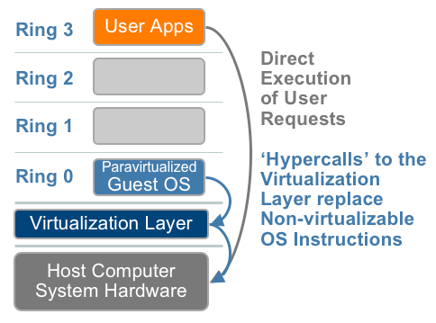
Technique 2: OS Assisted Virtualization or Paravirtualization (PV)
Paravirtualization refers to communication between the guest OS and the hypervisor to improve performance and efficiency.
Paravirtualization involves modifying the OS kernel to replace nonvirtualizable instructions with hypercalls that communicate directly with the virtualization layer hypervisor.
The hypervisor also provides hypercall
interfaces for other critical kernel
operations such as memory
management, interrupt
handling and time keeping.
Paravirtualization approach to x86 Virtualization
Notes:
In PV kernel is modified to send requests to XEN API on Dom0 and Dom0 executes the requests on cpu and then sends back to respective domu. CPU considers that request came from DOM0 and does not even know about virtualization. That is why PV does not require any special CPU.
In HVM we do not need to modify the kernel and VM is given access to cpu directly. Still the VM stays virtualized but CPU does know which VM has sent the request. That is why special CPU with vtx or amd virtualization is required.
PV: CPU is dumb, VM is genius :p HVM: VM is dumb, CPU is genius
When the guest OS is modified, it can no longer run directly on the hardware directly.
A hypercall is to a hypervisor what a syscall is to a kernel. A hypercall is a software trap from a domain to the hypervisor, just as a syscall is a software trap from an application to the kernel. Domains will use hypercalls to request privileged operations like updating pagetables.

Slide 7
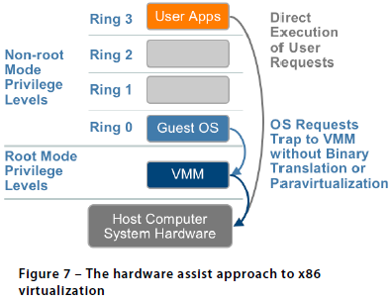
Technique 3: Hardware Assisted Virtualization (HVM)
Intel’s Virtualization Technology (VT-x) (e.g. Intel Xeon) and AMD’s AMD-V both target privileged instructions with a new CPU execution mode feature that allows the VMM to run in a new root mode below ring 0, also referred to as Ring 0P (for privileged root mode) while the Guest OS runs in Ring 0D (for de-privileged non-root mode).
Privileged and sensitive calls are
set to automatically trap to the
hypervisor and handled by
hardware, removing the need
for either binary translation or
para-virtualization.
Vmware only takes advantage
of these first generation
hardware features in limited
cases such as for 64-bit guest
support on Intel processors.
Notes:
It should be pointed out that full virtualization is not equal to HVM. Both of them can run VM without modifying the guest os. However, in full virtualization, VM's hardware is emulated by Qemu software. While HVM means the VM will run with hardware support. So, the performance in HVM will be better than that in full virtualization.
The guest state is stored in Virtual Machine Control Structures (VT-x) or Virtual Machine Control Blocks (AMD-V). Processors with Intel VT and AMD-V became available in 2006, so only newer systems contain these hardware assist features.
Due to high hypervisor to guest transition overhead and a rigid programming model, VMware’s binary translation approach currently outperforms first generation hardware assist implementations in most circumstances.
Second generation hardware assist technologies are in development that will have a greater impact on virtualization performance while reducing memory overhead. Both AMD and Intel have announced future development roadmaps, including hardware support for memory virtualization (AMD Nested Page Tables [NPT] and Intel Extended Page Tables [EPT]) as well as hardware support for device and I/O virtualization (Intel VT-d, AMD IOMMU).
Compute-intensive workloads already run well with binary translation of privileged instructions and direct execution of non-privileged instructions, but NPT/EPT will provide noticeable performance improvements for memory-remapping intensive workloads by removing the need for shadow page tables that consume system memory. Increased performance and reduced overhead expected in future CPUs will provide motivation to use hardware assist features much more broadly, but don’t expect revolutionary improvements. As processors get significantly faster each year, each year’s processor performance increases will likely have a greater impact on virtualization capacity and performance than future hardware assist optimizations.

Slide 8
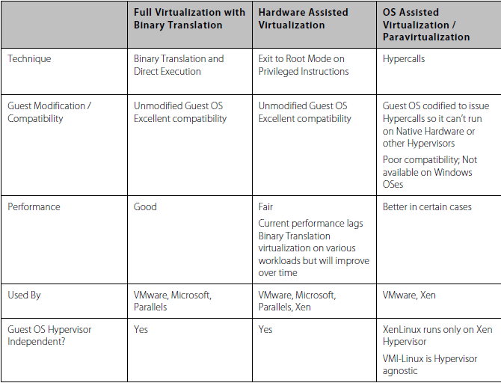
Summary Comparison of the Current State of x86 Virtualization Techniques
Notes:
The ability of the guest kernel to communicate directly with the hypervisor results in greater performance levels. Total virtualization, you’ll recall, inserts an entire hardware emulation layer between the guest operating system and the physical hardware. By contrast, paravirtualization’s thin software layer acts more like an air traffic controller for virtualized servers, allowing one guest OS access to the physical resources of the hardware while stopping all other guest OSs from accessing the same resources at the same time. This method is generally much more efficient than traditional hardware emulation virtualization The value proposition of paravirtualization is in lower virtualization overhead, but the performance advantage over full virtualization can vary greatly depending on the workload;
The second advantage of the paravirtualization approach compared to full virtualization is that paravirtualization does not limit you to the device drivers contained in the virtualization software; in fact, paravirtualization does not include any device drivers at all. Instead, it uses the device drivers contained in one of the guest operating systems, referred to as the privileged guest.

Slide 9
Full Virtualization vs. Paravirtualization
Paravirtualization is different from full virtualization, where the unmodified OS does not know it is virtualized and sensitive OS calls are trapped using binary translation at run time. In paravirtualization, these instructions are handled at compile time when the non-virtualizable OS instructions are replaced with hypercalls.
The advantage of paravirtualization is lower virtualization overhead, but the performance advantage of paravirtualization over full virtualization can vary greatly depending on the workload. Most user space workloads gain very little, and near native performance is not achieved for all workloads.
As paravirtualization cannot support unmodified operating systems (e.g. Windows 2000/XP), its compatibility and portability is poor.
Notes:
The ability of the guest kernel to communicate directly with the hypervisor results in greater performance levels. Total virtualization, you’ll recall, inserts an entire hardware emulation layer between the guest operating system and the physical hardware. By contrast, paravirtualization’s thin software layer acts more like an air traffic controller for virtualized servers, allowing one guest OS access to the physical resources of the hardware while stopping all other guest OSs from accessing the same resources at the same time. This method is generally much more efficient than traditional hardware emulation virtualization The value proposition of paravirtualization is in lower virtualization overhead, but the performance advantage over full virtualization can vary greatly depending on the workload;
The second advantage of the paravirtualization approach compared to full virtualization is that paravirtualization does not limit you to the device drivers contained in the virtualization software; in fact, paravirtualization does not include any device drivers at all. Instead, it uses the device drivers contained in one of the guest operating systems, referred to as the privileged guest.

Slide 10
Full Virtualization vs. Paravirtualization
Paravirtualization can also introduce significant support and maintainability issues in production environments as it requires deep OS kernel modifications. The invasive kernel modifications tightly couple the guest OS to the hypervisor with data structure dependencies, preventing the modified guest OS from running on other hypervisors or native hardware.
The open source Xen project is an example of paravirtualization that virtualizes the processor and memory using a modified Linux kernel and virtualizes the I/O using custom guest OS device drivers.
Notes:
Xen 3.x only recently introduced support for hardware assisted full virtualization of unmodified guest OSes (e.g. Windows). As VMware’s binary translation is far more sophisticated and higher performing than Xen's employment of first generation hardware assist, Xen vendors can’t compete with VMware’s overall performance, reliability, and ease of management.
PV on HVM
Paravirtual guests traditionally performed better with storage and network operations than HVM guests because they could leverage special drivers for I/O that avoided the overhead of emulating network and disk hardware, whereas HVM guests had to translate these instructions to emulated hardware. Now these PV drivers are available for HVM guests, so operating systems that cannot be ported to run in a paravirtualized environment (such as Windows) can still see performance advantages in storage and network I/O by using them. With these PV on HVM drivers, HVM guests can get the same, or better, performance than paravirtual guests.
As VMware sees it, the major problem with processor paravirtualization is the need for guest OS modification that makes it dependent on a specific hypervisor to run. The Xen interface, for example, implements deep paravirtualization with strong hypervisor dependency. The OS kernel is closely tied to structures in the hypervisor implementation. This creates an incompatibility as the XenLinux kernel can’t run on native hardware or other hypervisors, doubling the number of kernel distributions that have to be maintained. Additionally, it’s limited to newer, open source operating systems as the intrusive changes to the guest OS kernel require OS vendor support.

Slide 11
Memory Virtualization
This involves sharing the physical system memory and dynamically allocating it to virtual machines. VM memory virtualization is very similar to the virtual memory support provided by modern operating systems.
The operating system keeps mappings of virtual page numbers to physical page numbers stored in page tables. All modern x86 CPUs include a memory management unit (MMU) and a translation lookaside buffer (TLB) to optimize virtual memory performance.
To run multiple virtual machines on a single system, another level of memory virtualization is required. In other words, one has to virtualize the MMU to support the guest OS.

Slide 12
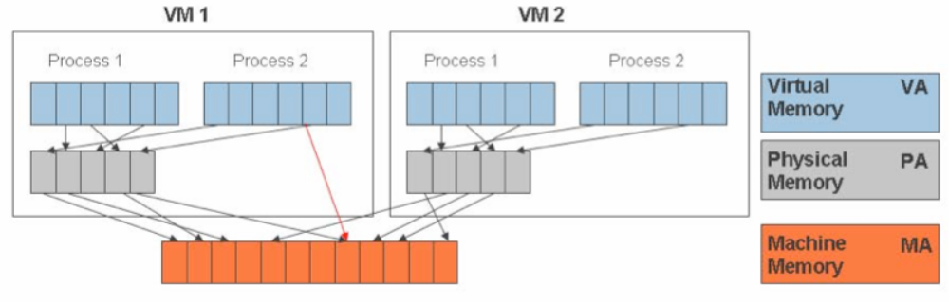
Memory Virtualization
The guest OS continues to control the mapping of virtual addresses to the guest memory physical addresses, but the guest OS cannot have direct access to the actual machine memory.
The VMM is responsible for mapping guest physical memory to the actual machine memory, and it uses shadow page tables to accelerate the mappings.
The VMM uses TLB hardware to map the virtual memory directly to the machine memory to avoid the two levels of translation on every access.
Notes:
When the guest OS
changes the virtual memory to physical memory mapping, the VMM updates the shadow page
tables to enable a direct lookup.

Slide 13
I/O Virtualization
I/O Virtualization involves managing the routing of I/O requests between virtual devices and the shared physical hardware.
The hypervisor virtualizes the physical hardware and presents each virtual machine with a standardized set of virtual devices.
These virtual devices effectively emulate well-known hardware (with device drivers) and translate the virtual machine requests to the system hardware.
This standardization on consistent device drivers also helps with virtual machine standardization and portability across platforms as all virtual machines are configured to run on the same virtual hardware regardless of the actual physical hardware in the system.

Slide 14
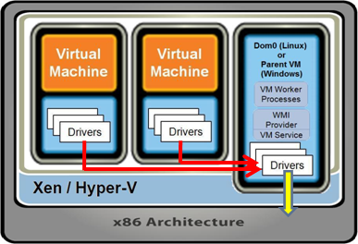
I/O Virtualization in Xen: Indirect driver model
Xen uses an indirect driver design that routes virtual machine I/O through device drivers in the Windows or Linux management operating systems.
Xen uses an indirect split driver model consisting of a front-end driver running in Domain U (user VMs) and the backend driver running in Domain 0. These two drivers interact with each other via a block of shared memory.
The front-end driver manages the I/O requests of the guest OS and the backend driver is responsible for managing the real I/O devices and multiplexing the I/O data of different VMs. These generic (standard) backend drivers installed in Linux or Windows OS can be overtaxed by the activity of multiple virtual machines and
are not optimized for multiple VM workloads.
There is also CPU overhead associated
with this approach because I/O is proxied
via Domain 0.
Notes:
The performance of a virtualized system should first be quantified in terms of latency and throughput, and then in terms of how efficiently resources are being used. For example, if a physical system is delivering 10000 transactions per minute at 500ms latency per transaction, then a virtualized system that is performing at 100% of native should provide the same level of throughput with acceptable latency characteristics. Secondary should be a metric of resource usage, which is a measure of how many additional physical resources were used to achieve the same level of performance. It’s sometimes overly easy to focus primarily on the CPU resource, when in reality memory and I/O are much more expensive resources to provision. This is becoming especially important going forward, as multicore CPUs continue to lower the cost per processor core, while memory cost remains at a premium.
More important for Oracle is the ability to scale up by taking advantage of multi-core CPUs, large memories, and the I/O throughput through the hypervisor to support the large number of disk spindles in the backend storage arrays.

Slide 15
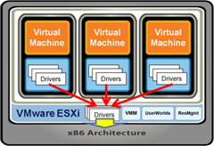
I/O Virtualization in VMWare ESXi: Direct driver model
ESXi uses a direct driver model that locates the device drivers that link virtual machines to physical devices directly in the ESXi hypervisor.
With the drivers in the hypervisor, VMware ESXi uses optimized and hardened device drivers and provides special treatment, in the form of CPU scheduling and memory resources, that they need to process I/O loads from multiple virtual machines.
Notes:
The VMware ESX direct driver model puts certified and hardened I/O drivers directly in the VMware ESX hypervisor. These drivers must pass rigorous testing and optimization steps performed jointly by VMware and the hardware vendors before they are certified for use with VMware ESX. With the drivers in the hypervisor, VMware ESX can provide them with the special treatment, in the form of CPU scheduling and memory resources, that they need to process I/O loads from multiple virtual machines. The Xen and Microsoft architectures rely on routing all virtual machine I/O to generic drivers installed in the Linux or Windows OS in the hypervisor’s management partition. These generic drivers can be overtaxed easily by the activity of multiple virtual machines – exactly the situation a true bare-metal hypervisor, such as ESXi, can avoid. Hyper-V and Xen both use generic drivers that are not optimized for multiple virtual machine workloads.
VMware investigated the indirect driver model, now used by Xen and Hyper-V, in early versions of VMware ESX and quickly found that the direct driver model provides much better scalability and performance as the number of virtual machines on a host increases.

Slide 16
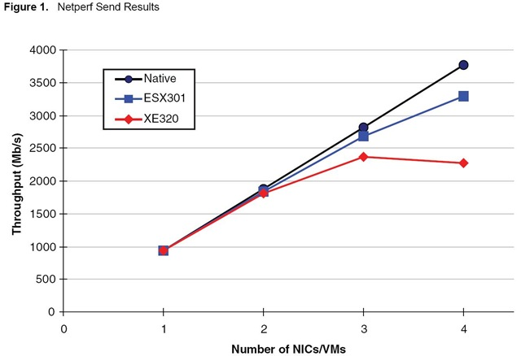
Scalability of VMWare and Xen driver models
VMware direct driver model scales better than the indirect driver model in Xen.
As shown in the chart below, Xen, which uses the indirect driver model, shows a severe I/O bottleneck with just three concurrent virtual machines, while VMware ESX continues to scale I/O throughput as virtual machines are added.

Slide 17
Reference
Overview of x86 Server Virtualization Technology
http://www.cubrid.org/blog/dev-platform/x86-server-virtualization-technology/

